Slide 1

A.I. vs online learning
2021
Kamil Monicz
Wojciech Buchwald
Notes:
WOJTEK
Come one, Come all. Welcome. My name is Wojciech Buchwald and today I joined forces with one and only Kamil Monicz to perform a daunting task of keeping you awake for the next 11-13 minutes. Our topic for today is ethical concerns about AI. I know I know, we’ve all already heard that theoretical yata yata, yata, robots bad, human race is doomed and so on. So, we took another approach to this topic. And we can proudly present…

Slide 2


D.I.Y Unethical AI If you insult it it’s gonna make you cry
100% FREE!
Notes:
WOJTEK
Say with deep voice: D.I.Y.
Unethical AI
If you insult it, it’s gonna make you cry.
That’s right. We will teach you some very naughty things and at the end, hopefully, you will be able to create your very own unethical AI at no cost. This presentation will guide you from the very beginning of how this idea came to a live, through the technical side of things, up to the actual LIVE demo which you will be able to interact with. And now, with no time to waste, let’s pop right into it.

Slide 3

11.03.2020 – The End of an era
Lockdown
Sorrow
Misery
Online learning
Notes:
WOJTEK
On March 11th, 2020 life as we know it come to an end. We finished our physics 2 tutorials and came home, knowing that we won’t be returning to the faculty for a few days. It was like out of season holiday, no classes for some time. Nobody seemed worried back then. We started online classes as a temporary solution with hopes of fast return to normal order.

Slide 4

AI – Simple use for abuse
Labs
Exams
Tasks
Showing off
Homework
Activity points
Coding
Presenting
Notes:
WOJTEK
And then days turned into weeks. Weeks into months, and we begin to realize that this is the new normal. And it will be for quite some time. The way that evaluation of learning progress is conducted was turned upside down. So, the question begins to rise. How to benefit from that? Well, allow us to present you, our approach.

Slide 5

Before we BEGIN…
Our rules for this project:
Create a personal AI at a no budget.
Complete the AI code in around 8 hours – it’s a single school project, please have some understanding.
Notes:
KAMIL
But before we begin, let’s state one thing clear.
While working on this project we decided to follow two rules:
First, Create a personal AI at a no budget.
And second, Complete the AI code in a reasonable timespan – something around 8 hours. We didn’t want to spend days making an AI which would be played once or twice so please be understanding as this is just a single school project and some shortcuts had to be made. In other words, this project is not perfect.
Having that checked, we are ready to move on.

Slide 6
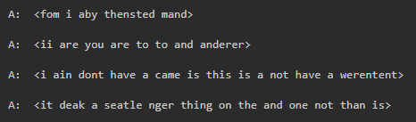
HOWTO: Answer generation
Possible approaches:
Character-by-character sentence completion, Word-by-word sentence completion.
Inspired by GPT.
Requires lots of data – seriously.
AI with creativity.
Things did not go as expected…
Notes:
KAMIL
Let’s start with what I think is the most interesting part of this project which is the answer generation. As you probably know, in programming there are many ways of achieving the same goal – some of them better, some of them worse. Same rule applies here. At the beginning we decided to make our AI complete sentences, which is fairly like how current GPT-3 works.
Run the animation.
However, we heavily underestimated the amount of data required to train our AI which resulted in the project being a complete flop. As an example, at some point our AI started to generate some funky sentences like:
I ain don’t have a came is this is a not have a werentent.

Slide 7
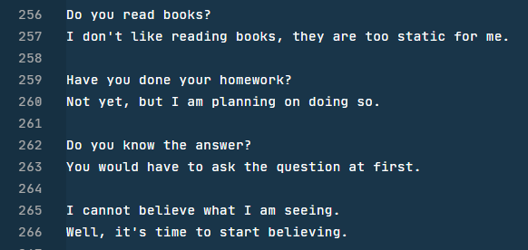
HOWTO: Answer generation
Possible approaches:
Calculating sentence similarities.
Just few hundred lines of training data.
AI without creativity.
X300 Q&As
Notes:
KAMIL
The other approach, which is also our final, is lot simpler, requires just a few hundred lines of training data and is super effective. I am talking about comparing sentence similarities and returning answers from the predefined list. The only downside is that this way our AI has no creativity, but that is something we are willing to sacrifice. Okay, but could you explain in detail?

Slide 8
HOWTO: Answer generation
96D vectors
How do you feel?
Text embedding SpaCy
Vector similarity
(0.34, 0.11, …)
How are you?
(0.12, 0.98, …)
0.97896…
Do you wash yourself? (A: Yes)
0.93…
Do you take bath?
What is the weather like? (A: It’s sunny)
0.45…
Sing me a song. (A: Fa la la la la…)
-0.13…
Notes:
KAMIL
The system works by first, embedding sentences into vectors using SpaCy which is an open-source library. Then to check how similar two sentences are, we simply compare their vectors. And that’s it – literally.
Run the animation.
As an example, let’s take the “Do you take bath?” question. We compare it to every question in the database and check which comparison resulted in the highest value which ranges from negative 1 to positive 1. We can see that this question is very similar to the “Do you wash yourself?” as it returned the highest value from all the matches. So naturally we check the predefined answer for that question and return it – in that case it is simply “Yes”.

Slide 9

HOWTO: Speech to text
def mic_to_text() -> str: result_text = None def cb_recognized(evt: speechsdk.SpeechRecognitionEventArgs): nonlocal result_text if not result_text and len(evt.result.text) > 0: result_text = evt.result.text speech_recognizer.recognized.connect(cb_recognized) speech_recognizer.start_continuous_recognition() cli_ui.info_1('Listening...') while not result_text: time.sleep(0.05) speech_recognizer.stop_continuous_recognition() assert isinstance(result_text, str) return result_text
5H audio per month = Free
Notes:
KAMIL
For the rest of this project, we ended up using Microsoft Azure’s Cognitive Services which are free for limited use. First, let me explain the speech-to-text module.
Explain the code.

Slide 10
HOWTO: text to speech
def text_to_wav(text: str, path: str) -> bool: if os.path.exists(path): return True result = speech_synthesizer.speak_text(text) if len(result.audio_data) < 1: return False stream = speechsdk.AudioDataStream(result) stream.save_to_wav_file(path) return True
5M chars per month = Free
Notes:
KAMIL
And now, the text-to-speech module which is even simpler.
Explain the code.

Slide 11

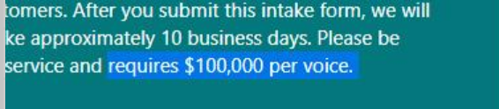
HOWNOTTO: CUSTOM VOICE MODEL
Microsoft Azure provides custom neural language models
Requires you to upload +300 samples of transcribed voice recordings.
Only data upload is available for free.
Notes:
KAMIL
That’s all fine and good but what didn’t go right?
Our desire was to create a custom voice model to produce text-to-speech sentences with our own, personal voices. At first, Microsoft Azure seemed like to provide such a feature, so we went on with it. We recorded our voice samples, packed it up and uploaded.
Run the animation.
After the upload part we were greeted with a happy Google form which stated that we must apply for this feature as it is still in the BETA and make a payment of $100,000 per voice model which just slightly exceeded our budget for this project – obviously, we gave it a pass.

Slide 12

Is this where it all ends?
Custom voice models are too expensive for ordinary people.
Was it all for nothing?
Have we failed?
Notes:
WOJTEK
And was that it? Our hopes shattered? Our dreams ruined by corporate greed? It sure looked like it when we found out that message. But before you start throwing tomatoes at us just give us one more chance. One final trick. Because you see…
Maybe now we can’t afford it, but it still exists, and maybe tomorrow some lonely hacker will make its code open source. And now. Allow us to take you into such dark distant future, when You would be professors here, and You would have to face this AI with all of its capabilities.

Slide 13



A wild MiNI Student appeared!!!
Notes:
WOJTEK
Wait, what is this?
It can’t be…
Is it…?
Is it the Differential Equations online oral exam?

Slide 14
AI is listening…
You can ask your questions via the microphone.
Any personal question you feel like.
What is your name?
Do you have any hobbies?
Tell me the fundamental theorem of calculus.
What does the central limit theorem say?

Slide 15

THE END
Full source code available at: https://github.com/Zaczero/PersonalAI-2021
Presented by Kamil Monicz & Wojciech Buchwald
Notes:
WOJTEK
Some final words from real me. The whole source code is available for you on the GitHub repository linked on the screen. I hope you had a great time during our presentation and that you won’t think about this time as being wasted. Thank you.

